Slide 1
Set 1 Level 2
Maths Assessment Test

Slide 2
Count these apples:
1 mark
L2/N1

Slide 3
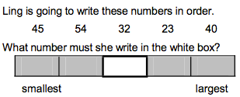
2 marks
L2/N2

Slide 4
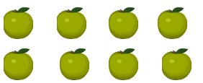
Half of these apples are going to be put into the box.
How many will go in the box?
1 mark
L2/N3

Slide 5
6 + 8 = 14
Complete the following number sentences:
3 marks
..... + ..... = .....
..... - ..... = .....
..... - ..... = .....
L2/C1

Slide 6
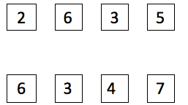
Draw lines to match up the pairs of numbers that have a sum of 9.
2 marks
L2/C2

Slide 7
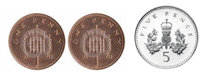
How much more do I need to make 10p?
2 marks
L2/C3

Slide 8
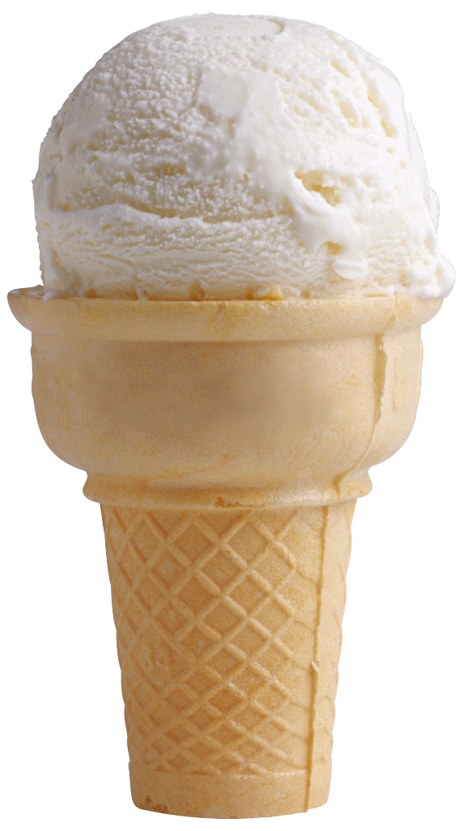
A shop had 25 ice creams.
8 were sold and so there were 17 left.
Write a number sentence to show what happened.
2 marks
L2/C4

Slide 9

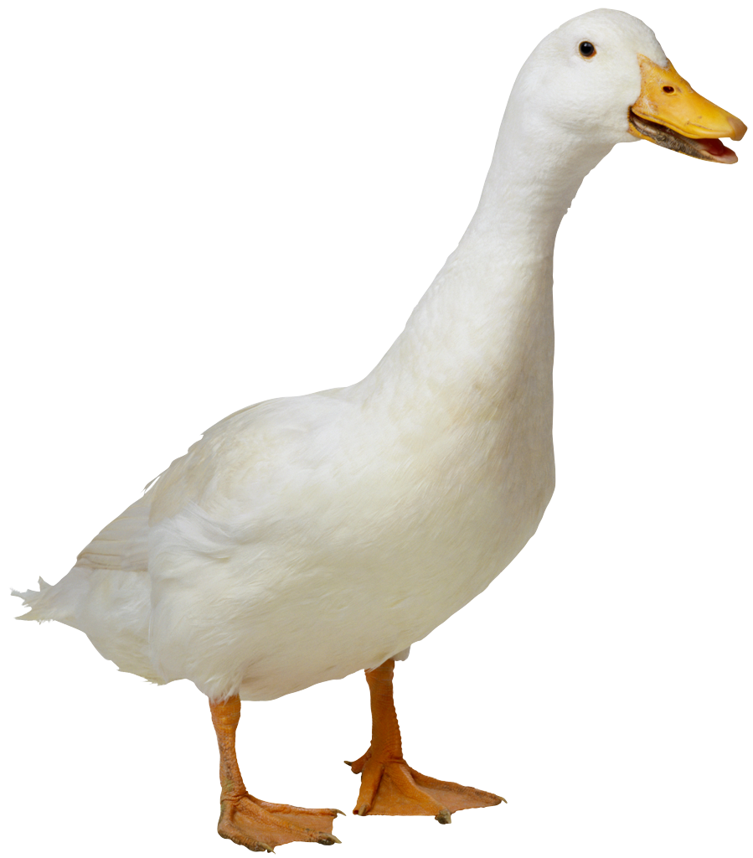
15 ducks were on a pond.
11 flew away.
How many were left?
1 mark
L2/C5

Slide 10
Draw a circle around the even numbers in the list:
8 9 10 11 12 13 14 15
2 marks
L2/A1

Slide 11
Tick the shapes that are triangles.
2 marks
Name the shape in the middle
L2/S1

Slide 12


Complete the table
2 marks
Number
of faces
Number
of corners
8
5
L2/S2

Slide 13
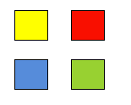

Put a cross under the box that describes where the blue square is.
1 mark
L2/S3

Slide 14
Tick the shape the boy is thinking of
1 mark
L2/S4

Slide 15
The height of the door to your classroom is :
Choose the best answer:
1 mark
2 centimetres 2 metres 2 miles
2 kilograms 20 centimetres
L2/S5

Slide 16
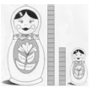
Ann measured the height of these dolls using blocks.
How many blocks taller is the big doll than the small doll?
1 mark
L2/S6

Slide 17
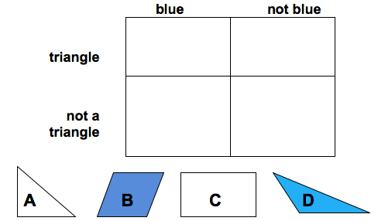
Put the correct letter in the correct box on the diagram.
2 marks
L2/HD1

Slide 18
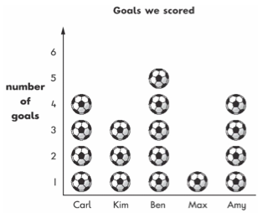
Look at the chart.
Write which child scored the most goals.
1 mark
L2/HD2

Slide 19
Jo wanted to find out whether the children in her class liked carrots or peas.
Here are her survey results: peas peas peas carrots carrots peas carrots peas peas peas
Complete the table to show her results
 | Frequency
Carrots
Peas
1 mark
L2/HD3

Slide 20
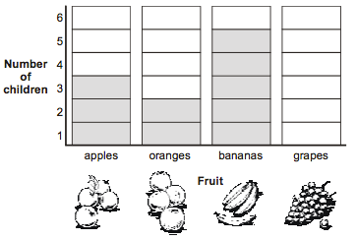
Here is a chart showing children’s favourite fruit.
1 mark
4 children like grapes best.
Show this on the chart
L2/HD4

Slide 21
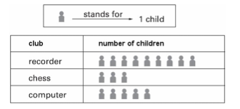
The chart shows the clubs that children in Acorn Class are in.
1 mark
How many children are in the computer club?
L2/HD5

